Slide 1
Intro to ML
DSGT

Slide 2
Three Ways to Consider
Models and Computation
Picture Representation
Decision Boundaries
Mathematical Formulation

Slide 3
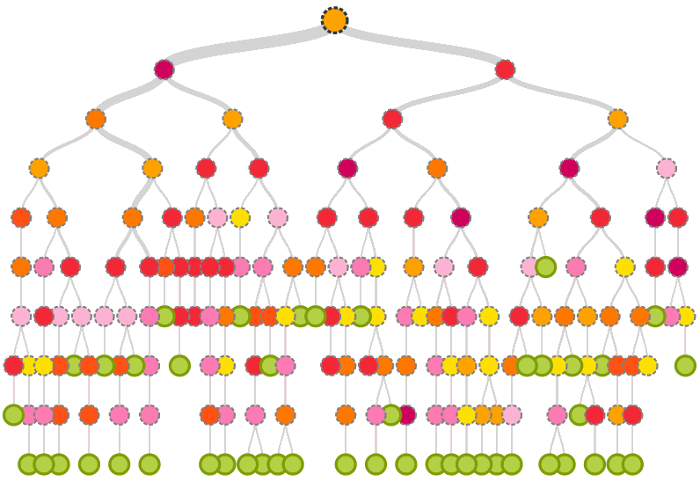
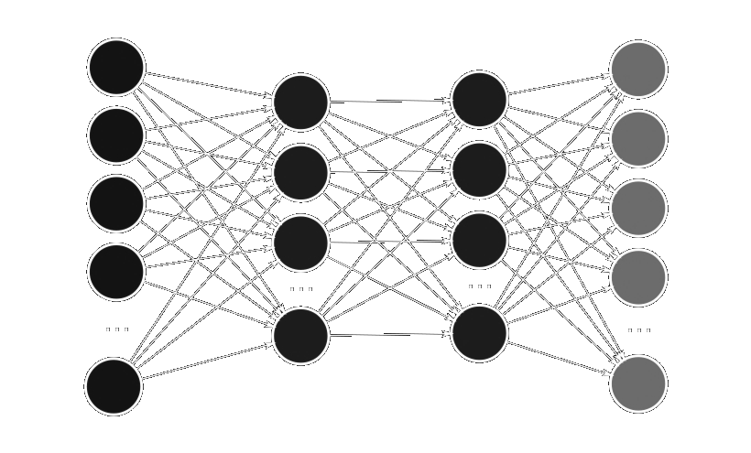
1) Pictorial Representations

Slide 4
2) Decision Boundaries
SVM
Decision Tree
Neural Network
Notes:
Mention linear and nonlinear

Slide 5

3) Math Formulation
Discover a mapping function representing input output relationships
Example:
y = f(x) + e
f: X → Y
f: X → Y
Image → Label
Jellyfish

Slide 6

Parameters
Parameters

Slide 7
Parameters
Parameters
x₁ | x_{1,2}
x₂ | x_{2,2}
x₃ | x_{3,2}
y₁
y₂
y₃
θ₁
θ₂
=

Slide 8




Classification v. Regression
$200,000
Spam
9.5/10
Bear

Slide 9
Clustering
 | Feature | Feature | Feature
Expt | 2342.23 | 674.56 | 11234.5
Expt | 1234.13 | 3423.5 | 256.23
Expt | 123.53 | 954.3 | 2345.5
Expt | 43345.3 | 847.34 | 763.432
Expt | 34598.5 | 845.5 | 4365.4
Expt | 8564.3 | 743.2 | 9765.3
Expt | 54634.3 | 1345.3 | 98623.4
Regression
Clustering

Slide 10
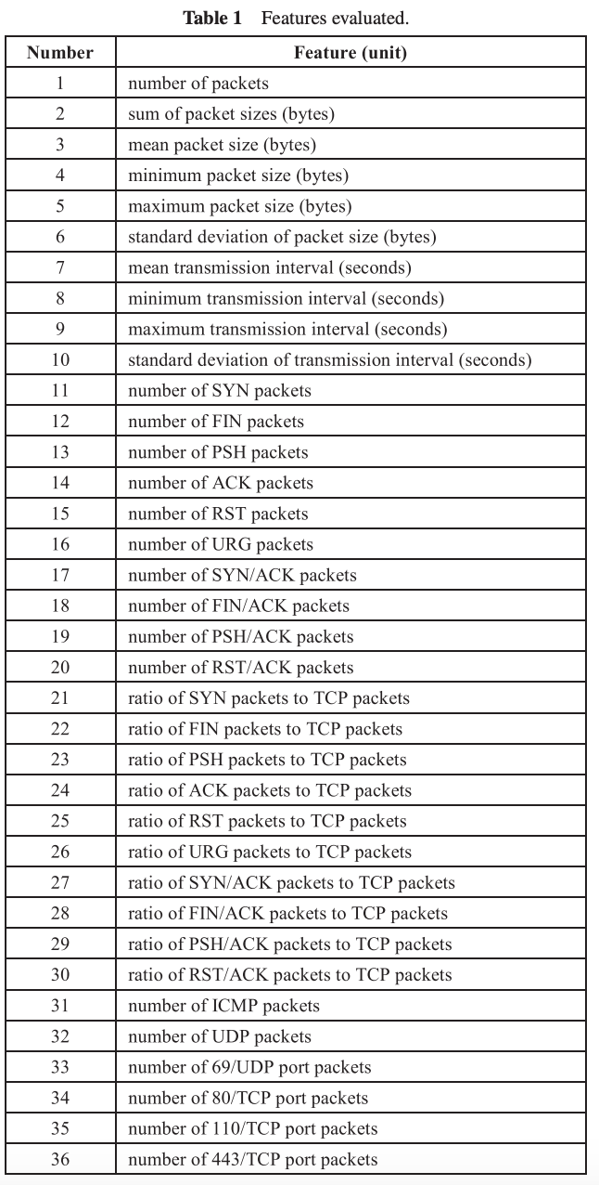

Dimensionality Reduction

Slide 11
Classification

Slide 12
SVM
Hyperplane
Maximum Margin
Multidimensional
Kernel for nonlinearity

Slide 13
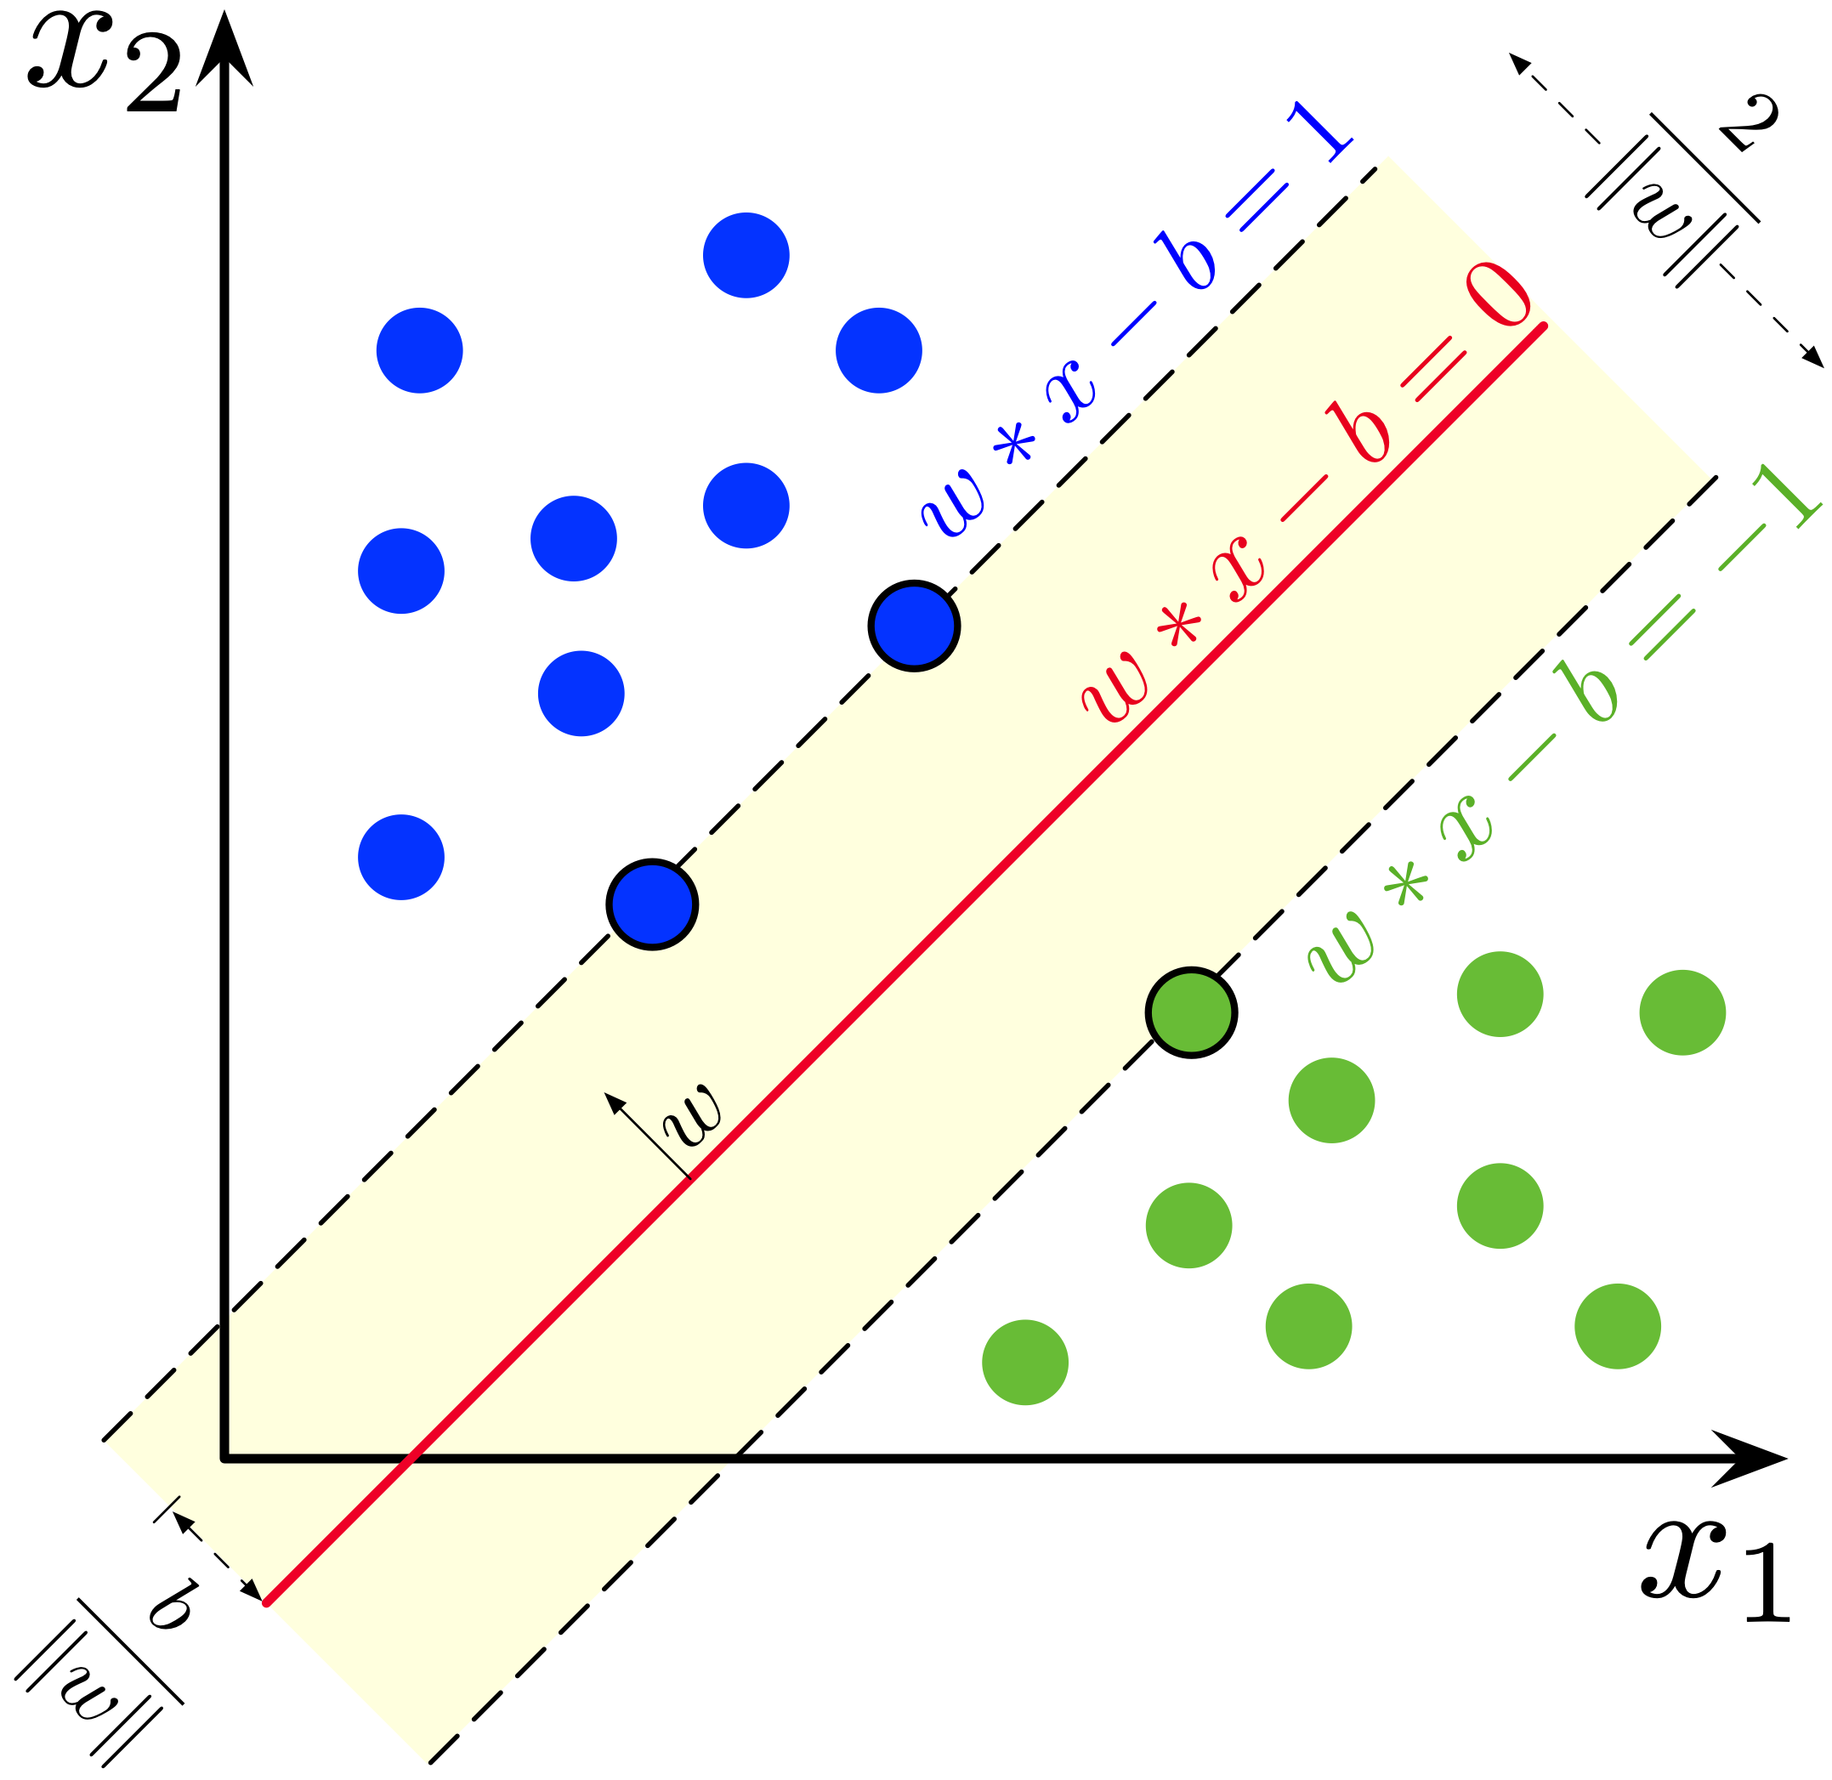
SVM
Hyperplane
Maximum Margin
Multidimensional
Kernel for nonlinearity

Slide 14
Decision Tree

Slide 15
Decision Tree
Leafs, branches
Information Gain

Slide 16
Feed-Forward Neural Net
Forward Propagation
Weights/Biases
Activations
Nonlinear

Slide 17
Regression

Slide 18
Intuition
?
How can we fit this data to make a prediction?

Slide 19

Linear vs Polynomial

Slide 20
Clustering

Slide 21
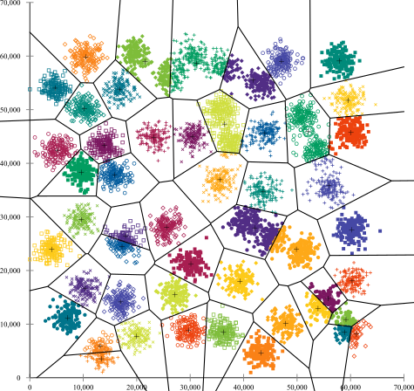
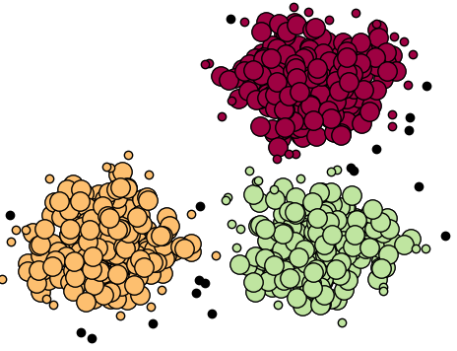
K-Means

Slide 22
Agglomerative Clustering

Slide 23
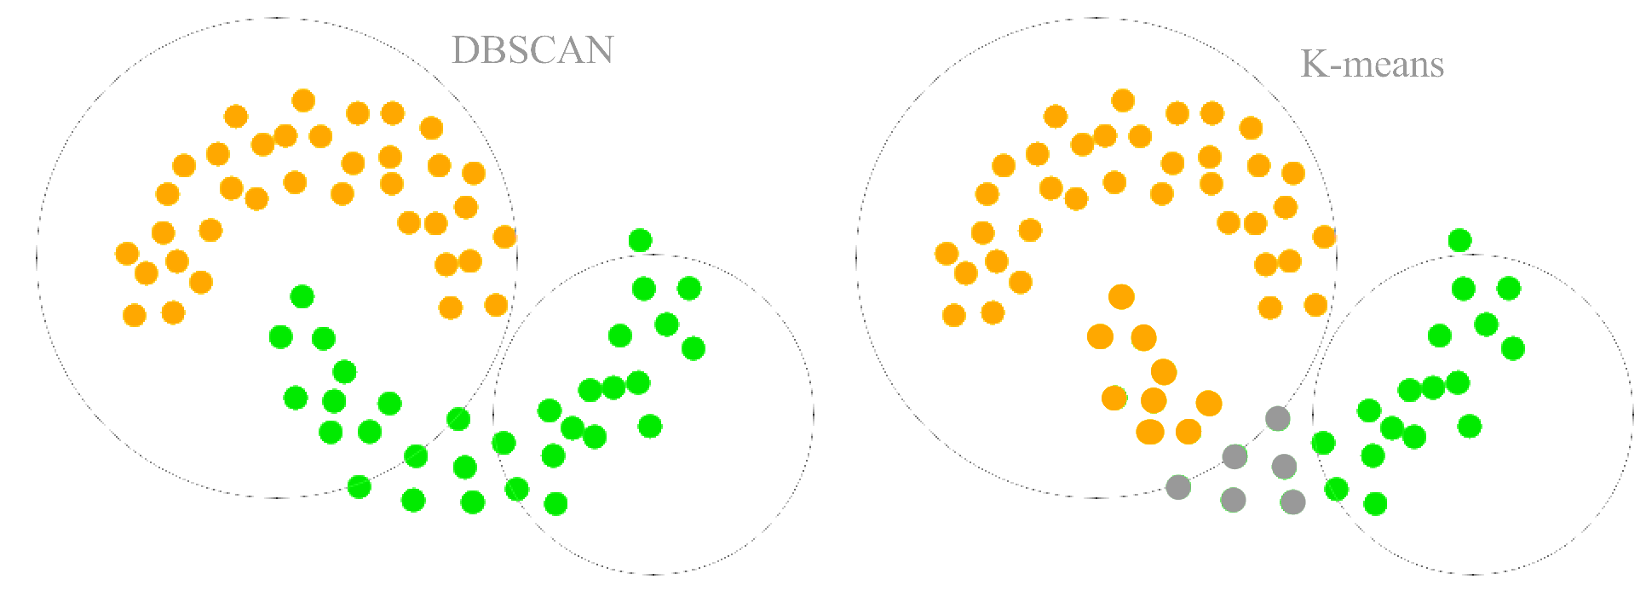
Density-Based (DBSCAN)
Noise
Core
Border

